Slide 1

Writing English Papers
《学术英语论文写作》
Lecturer: Liu Xindan

Slide 2

Chapter 4 Abstract

Slide 3

Abstract
Writing Research Papers
Chapter 4
1. The Introduction
2. Types of Abstracts
3. Qualities of a Good Abstract
4. Approaches to Writing an Abstract
Contents
Chapter 4 Abstract

Slide 4

Abstract
Writing Research Papers
Chapter 4
1.1 Definition of Abstract
1.2 Features of Abstracts
1.3 Content of an Abstract
Chapter 4 Abstract

Slide 5
Abstract--1. Introduction
Writing Research Papers
Chapter 4
1.1 Definition of Abstract
An abstract is a highly condensed version of a longer piece of writing that highlights the major points covered, concisely describes the content and scope of the writing, and reviews the writing’s contents in abbreviated form.
Chapter 4 Abstract

Slide 6
Abstract--1. Introduction
Writing Research Papers
Chapter 4
1.2 Features of Abstracts
--avoid repetition;
--usually are limited to one paragraph of no more than 250 words;
--can stand alone;
Chapter 4 Abstract

Slide 7
Abstract--1. Introduction
Writing Research Papers
Chapter 4
1.2 Features of Abstracts
--use the third person;
--use the passive voice;
--are highly signposted
Chapter 4 Abstract

Slide 8
Abstract--1. Introduction
Writing Research Papers
Chapter 4
1.3 Content of An Abstract
---a clear statement of the problem
---the purpose of the paper
---the methods applied in research
---where and how you obtain your information
---how you use the data to make your points
Chapter 4 Abstract

Slide 9
Abstract--1. Introduction
Writing Research Papers
Chapter 4
1.3 Content of An Abstract
---an outline of your system of analysis
---statement of your result or finding
---enlightment of your research
Chapter 4 Abstract

Slide 10
Abstract--1. Introduction
Writing Research Papers
Chapter 4
Topic Specification (TS)
Background Information (BI)
Purpose Statement (PS)
Methodology and Data (MD)
Results/Findings (RF)
Implications/Conclusions (IC)
Chapter 4 Abstract

Slide 11
Abstract--2. Types of Abstracts
Writing Research Papers
Chapter 4
There are usually four types of abstracts: indicative, informative, informative-indictive, and structured.
Chapter 4 Abstract

Slide 12
Abstract--2. Types of Abstracts
Writing Research Papers
Chapter 4
Indicative abstracts (说明性摘要) are often used for theoretical papers, they are short and terse.
Informative abstracts (信息性摘要) are used mainly for experimental and technical papers.The research purpose, the methods, the key data and experimental results are reported; therefore, the contents are broader and they are relatively longer.
Chapter 4 Abstract

Slide 13
Abstract--2. Types of Abstracts
Writing Research Papers
Chapter 4
Informative-indicative abstracts report the higher-value information of the paper as in informative abstracts, while reporting other less important information of the paper in the indicative approach.
Structured abstracts are usually divided into purpose, methods, results and conclusions to facilitate reader comprehension.
Chapter 4 Abstract

Slide 14
Abstract--2. Types of Abstracts
Writing Research Papers
Chapter 4
(1) Indicative Abstracts
descriptive abstracts or introductory abstracts
mainly introduce the point of view or research purposes of the paper rather than the research methods, findings and conclusions
no explanation or comment should be added
the length is only between 30 to 50 words
suitable for complex or lengthy documents such as literature review, the whole or the entire collection of monographs
Chapter 4 Abstract

Slide 15
Abstract--2. Types of Abstracts
Writing Research Papers
Chapter 4
tell readers what information the report, article, or paper contains
do not provide results, conclusions, or recommendations
introduce the subject to readers, who must then read the report, article, or paper to find out the author’s results, conclusions, or recommendations
Chapter 4 Abstract

Slide 16
Abstract--2. Types of Abstracts
Writing Research Papers
Chapter 4
Example 1
Small RNA Regulators of Gene Expression
This year, the Lasker Foundation recognizes Victor Ambros, Gary Ruvkun, and David Baulcombe for their pioneering work elucidating the role of short RNA species in the posttranscriptional regulation of eukaryotic gene expression. (Neilson and Sharp, 2008: 899)
Chapter 4 Abstract

Slide 17
Abstract--2. Types of Abstracts
Writing Research Papers
Chapter 4
Example 2
OSCILLATIONS IN GRANULAR DYNAMICS
A new effect of granular dynamics in a bounded domain is reported. Oscillations arise when the system evolves from a given (non-equilibrium) initial state. The oscillations obtained are of importance for vibrated granular systems since they reveal some kind of fundamental frequencies and they lead to resonant frequencies under vibration. (Loguinova and Vlasov, 2007: 287)
Chapter 4 Abstract

Slide 18
Abstract--2. Types of Abstracts
Writing Research Papers
Chapter 4
Example 3
Autism: Many Genes, Common Pathways?
Autism is a heterogeneous neurodevelopmental syndrome with a complex genetic etiology. It is still not clear whether autism comprises a vast collection of different disorders akin to intellectual disability or a few disorders sharing common aberrant pathways. Unifying principles among cases of autism are likely to be at the leavel of brain circuitry in addition to molecular pathways. (Geschwind, 2008: 391)
Chapter 4 Abstract

Slide 19
Abstract--2. Types of Abstracts
Writing Research Papers
Chapter 4
(2) Informative Abstracts
Informative abstracts outline the scope and content of the paper, including research purposes, methods, results and conclusions. Because of its inherent characteristics, the informative abstract is particularly suitable for experimental studies. Most of academic journal articles use informative abstracts, and the word limit is in general between 100~150 words. Comparatively speaking, they are longer than indicative abstracts and informative-indicative abstracts.
Chapter 4 Abstract

Slide 20
Abstract--2. Types of Abstracts
Writing Research Papers
Chapter 4
Informative abstracts usually:
communicate specific information from the report, article, or paper.
include the purpose, methods, and scope of the report, article, or paper.
provide the results, conclusions, and recommendations.
are short-from a paragraph to a page or two, depending upon the length of the original work being abstracted. Usually informative abstracts are 10% or less of the length of the original piece.
allow readers to decide whether they want to read the report, article, or paper.
Chapter 4 Abstract

Slide 21
Abstract--2. Types of Abstracts
Writing Research Papers
Chapter 4
Example
SIZE INSTABILITIES IN THE RING AND LINEAR ARRAYS OF CHAOTIC SYSTEMS
We investigate the dynamical stabilities of ring and linear arrays of chaotic oscillators with asymmetric nearest-neighbor and long-range couplings. It is shown that the instabilities of complete chaotic synchronization occur as the numbers of oscillators are increased beyond critical values which depend on the coupling schemes and coupling parameters of the systems. Based on the master stability function and eigenvalue analysis methods, we give the semi-analytical relations between the critical values and the coupling parameters. Results are demonstrated with numerical simulations in a set of coupled Lorenz oscillators. (Qi, Huang and Wang 2007: 301)
Chapter 4 Abstract

Slide 22
Abstract--2. Types of Abstracts
Writing Research Papers
Chapter 4
(3) Informative-Indicative Abstracts
have the characteristics of both informative and indicative abstracts
they are restricted by the length of abstract and type and style of literature
introduce the major part of the literature in an informative manner while presenting the secondary elements in an indicative manner
relatively longer than indicative abstracts, but shorter than informative abstracts, generally between 50~100 words
Chapter 4 Abstract

Slide 23
Example 1
Why Do Customers Get More Than They Need? How Organizational Culture
Shapes Product Capability Decisions
The capability level of a product that a firm provides to a customer is an important marketing decision. In the extant literature, the normative heuristic for this decision is one of matching-of providing product capability levels that meet customer needs. However, industry evidence suggests that supplier firms routinely make product decisions that lead to “overshot” customers, whereby customers receive products with capabilities that exceed their requirements. The authors demonstrate how a supplier firm’s organizational culture can cause overshooting scenarios and how these effects can be attenuated to the extent that the focal firm’s basic values also reflect a customer orientation. (Lukas et al. 2013: 1)

Slide 24
Example 2
Autism and Brain Development
Genetic studies are refining our understanding of neurodevelopmental mechanisms in autism. Some autism-related mutations appear to disrupt genes regulated by neuronal activity, which are especially important in development of the postnatal nervous system. Gene replacement studies in mice indicate that the developmental window to ameliorate symptoms may be wider than previously anticipated. (Morrow, W., & Rubenstein, 2008： 396)

Slide 25
Abstract--2. Types of Abstracts
Writing Research Papers
Chapter 4
(4) Structured Abstracts
Different from other traditional abstracts, structured abstracts mark the Aim, Methods, Results and Conclusion headings with eye-catching font (bold, upper case or italics) for the reader. The content of the abstract is keeping with the content of the paper, often including research purposes, research methods, findings and conclusions, mainly used in medical and health sciences.
Chapter 4 Abstract

Slide 26
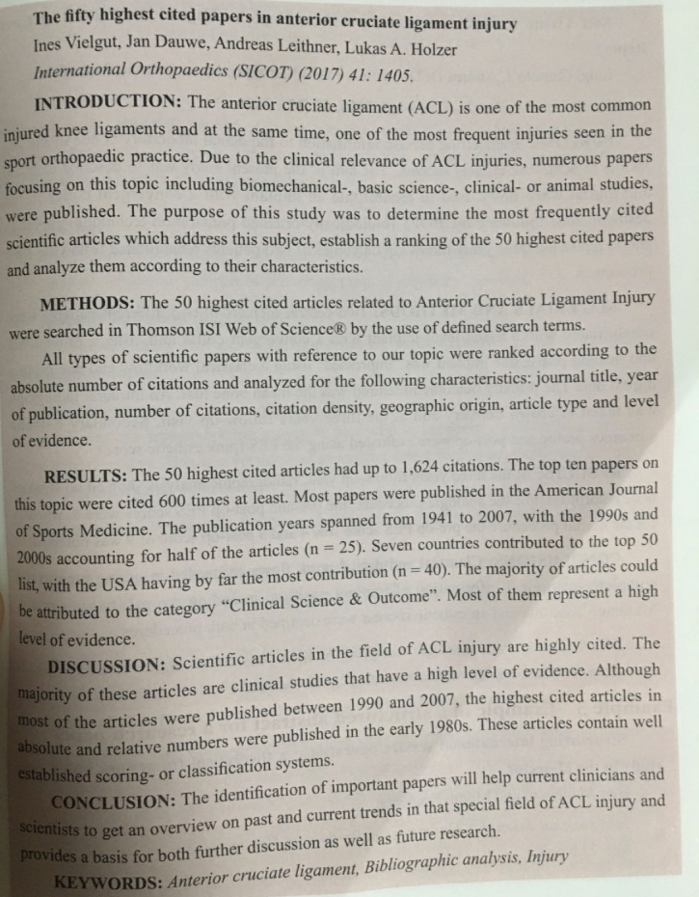

Slide 27
Abstract--3. Qualities of a Good Abstract
Writing Research Papers
Chapter 4
An effective abstract has the following qualities:
able to stand alone
uses keywords
uses one or more well developed, unified, coherent and concise paragraphs
uses an introduction/body/conclusion structure presenting the purpose, results, conclusions, and recommendations in that order
follows strictly the chronology of the article, paper, or report
Chapter 4 Abstract

Slide 28
Abstract--3. Qualities of a Good Abstract
Writing Research Papers
Chapter 4
provides logical connections between the information included
does not include unnecessary details
adds no new information, but simply summarizes the report
is understandable to a wide audience
adheres closely to the length given
often uses passive verbs to downplay the author and emphasize the information.
Chapter 4 Abstract

Slide 29
Abstract--4. Approaches to Writing an Abstract
Writing Research Papers
Chapter 4
---cut out unnecessary details of the paper and rewrite it
---find dispensible elements of the thesis and put them together
---find the thesis statement first and then the topic sentences of the
outline
Chapter 4 Abstract

Slide 30
Abstract--4. Approaches to Writing an Abstract
Writing Research Papers
Chapter 4
---use passive voice
---use third person
---use complex sentences
---avoid citation of references
---avoid abbreviation and specialized words
---avoid figures or table from the paper
Chapter 4 Abstract

Slide 31
Exercise 1 Analyze the abstract given below, paying special attention to such factors as the purpose, methods, results and conclusion.
Abstract
Corpus-based approaches to researching metaphor use in business English have become increasingly prevalent, but metaphor use in the genre of mission statements has received little attention. Using a self-built corpus with the help of the corpus tool Wmatrix, we compared metaphor use as a discursive and cognitive strategy in the mission statements of Chinese and US companies from a cognitive sociolinguistic perspective, focusing on three conventional conceptual metaphors in business discourse: BRANDS ARE PEOPLE, BUSINESS IS COOPERATION, and BUSINESS IS COMPETITION. The use of the source domains of these conceptual metaphors was found to differ significantly in the mission statements of Chinese and US companies, thus revealing differences in the underlying corporate identities and ideologies. Chinese corporations, which tend to describe themselves as energetic leaders and strong competitors, are more competition-oriented, whereas US corporations, which tend to project themselves as ethical and responsible community members, are more cooperation-oriented. The findings of this comparative study can shed light on how Chinese companies build their brand images and thus lead to a better understanding of changing national image of China.

Slide 32
Exercise2: Please analyze the following abstract written by an MA candidate on the title given.
An Evaluation on the Advanced English Course
Abstract: Course evaluation can provide information about student, discipline, institutional priorities, and also information about what is happening, what is working, and what isn’t. Based on this information, people could make decisions about revisions in the program and can report the project externally to develop and improve the course. Therefore, in order to develop and improve the course of Advanced English of non-English majors of Beijing International Studies University to finally promote the development of students, the writer evaluated the Advanced English Course of two junior classes of non-English majors of this university to find out some problems existing in this course by questionnaire. After collecting and analyzing the data, the writer found four problems existing in Advanced English course and got implications from these problems.

Slide 33
The End

